Slide 1
Human Activity Recognition
Bivas Maiti (bmaiti), Darshan Shinde (dshinde), Virendra Wali (vwali)

Slide 2
Motivation
Human activity recognition is important and challenging research area with many applications in healthcare, sports, entertainment and security.
Computer vision technique have been widely used for human activity tracking, but they mostly require infrastructure support.
It can be very helpful in healthcare sector for tracking patients physical improvement after surgeries.

Slide 3
Previous work
Using random forest and feature engineering on data collected by single accelerometer
Hidden Markov Model
Benchmarked accuracy on PAMAP2 dataset

Slide 4
Challenges
Inter-class variability: A lot of activities performed require similar kind of movements but are actually different.
Intra-class variability: Same activity can be performed by two users in widely different way.

Slide 5
Questions
For a given individual, can we predict the activity based on provided 5 seconds of data coming from on-body sensors?
For a given activity, can we identify the subject based on provided 5 seconds of data coming from on-body sensors?
By using the knowledge learnt in previous two problems can we develop a more generalized system which can predict the activity without any prior information about the subject?

Slide 6
Dataset (PAMAP2)
Source - UCI Machine Learning Repository
Donated by - Attila Reiss, Department Augmented Vision, DFKI, Germany
9 subjects, performing 18 different physical activities
3 Colibri wireless inertial measurement unit (IMU)
Heart rate monitor

Slide 7
Sensors used for data collection
Accelerometer
Magnetometer
Gyroscope
Heart Rate Monitor
Thermometer

Slide 8
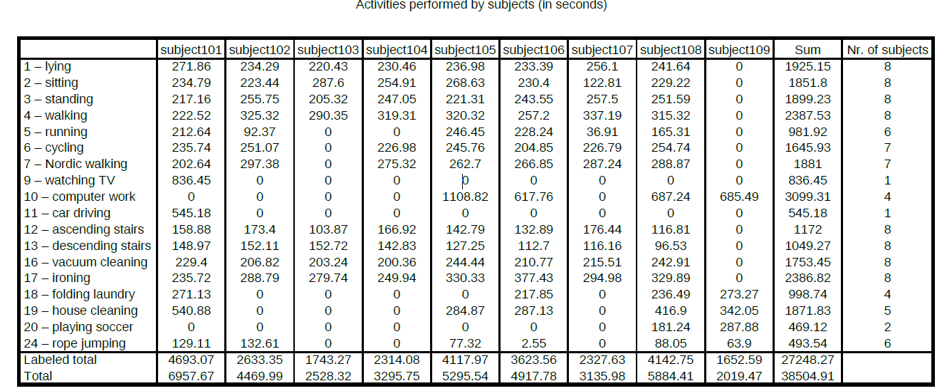
Activities summary

Slide 9
Data preprocessing
Data is synchronized but preprocessing to be done
NaN Interpolation
Data is highly unbalanced - Needed Class Weights
Segregated Data based on Questions
Creating a window of 5.12 seconds with a stride of 1 second
This will result in increment of features by a factor of 512

Slide 10
Problem specific data
For the question of predicting subject for given activity, we need data files for each activity which will have all data columns except activityId and will have an extra column of subjectId which will be treated as target label in this case.
For the question of predicting activity for given subject, we need data files for each subject which will have all data columns and in this case activityId column will be treated as target label.

Slide 11
Data segmentation
Sensor data of 10 milliseconds is not enough to identify activity.
In most cases, it’s hard to find exact boundary between two simultaneous activities.

Slide 12
Data segmentation (sliding window)
For window size = 5, stride = 2
Sequence # | Data
1 | 10
2 | 2
3 | 5
4 | 16
5 | 2
6 | 6
7 | 8
8 | 11
9 | 5
10 | 14
11 | 4
12 | 10
13 | 2
10 | 2 | 5 | 16 | 2
5 | 16 | 2 | 6 | 8
2 | 6 | 8 | 11 | 5
8 | 11 | 5 | 14 | 4
5 | 14 | 4 | 10 | 2
Features Before Windowing = 1
Features After Windowing = 5
Features after windowing in our dataset=15K(approx)!

Slide 13
Models Implemented
Logistic Regression
Decision Trees
K-Nearest Neighbors
Naïve Bayes
Light GBM

Slide 14
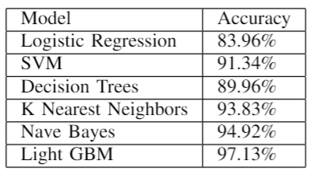
Experiments
Predict activity given subject
Given 5 seconds of data of a subject, what is the activity?
The model was trained on only 1 subject, and tested on the single subject.
The results of this are expected to be high.

Slide 15
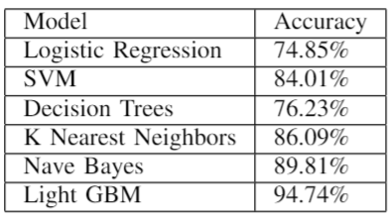
Experiments
Predict subject given activity
The goal is to predict the subject for a given activity.
The motivation for this question is to check the correlation of a subject with the activity.
Dropped ‘temperature’ data present in each IMU.

Slide 16
Experiments
Consider subject specific features like height, weight, resting heart rate, maximum heart rate, dominant hand, etc. and perform the same experiments
Model | Without Human Features | With Human Features | Benchmark
Decision Tree | 84.76% | 86.69% | 95.46%
SVM | 91.49% | 90.62% | NA
Logistic Regression | 75.48% | 74.62% | NA
Nave Bayes | 91.26% | 90.57% | 94.38%
Boosted Tree* | 97.55% | 98.24% | 99.69%
KNN | 93.76% | 94.23% | 99.25%

Slide 17
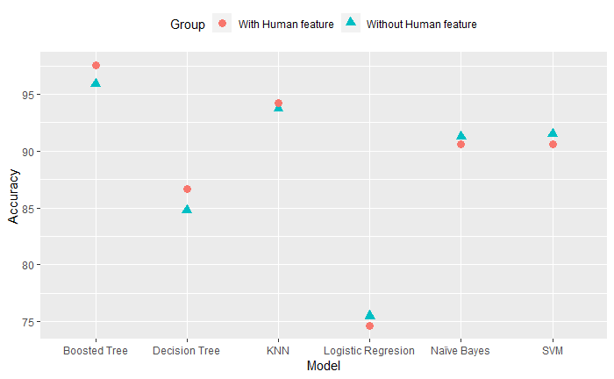
Experiments
Predict activity without subject
CV (cross validation)

Slide 18
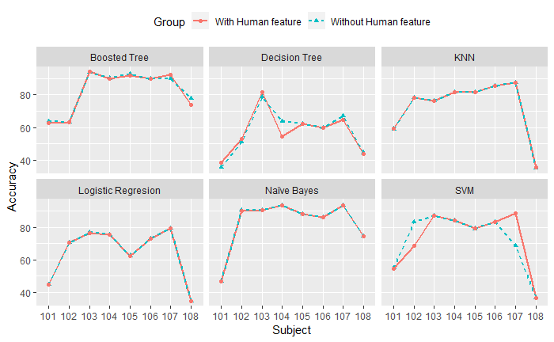
Experiments
Predict activity without subject
LOSO (Leave One Subject Out)

Slide 19
Future work
Try to reduce number of features by finding most important sensors.
Build a model to support more types of activities.
Find out the effect of number of sensors and their positions.

